Slide 1
Assignment 2 Unit 13
Assessment Title Website Design
link

Slide 2
Intended purpose and requirements
The purpose of the website I'm developing is to advertise a music festival on Michael Simpson land, I meant to design appropriate review and evaluate my website I've created.
The are requirements are at least 8 web pages,
an attention-grabbing index,
page with images of the bands playing,
interactive media live videos and songs as well as history and more information about the band,
A newsletter subscription page location page for where they are playing,
ecommerce page for merchandise in a table,
ecommerce site for selling tickets,
contact detail page for contacting the band.
Their site must be easy to navigate and simple to use for purpose of selling tickets to the audience, it must have a table to display the band's performing.
Target audience
The target audience for this website will be anybody interested in the band's music which is mainly older people and people generally interested in British folk music. They are people who would probably of already listened to their music and might be fans of the band and are probably interested in some of their upcoming festivals or buying some merch and music.
User requirements
The website's users will require the location of the festival and when each band is performing. The website's users will require the price of tickets and merchandise being sold as well as what facilities are being provided at different festivals.
The users will also require clear navigation to the information they need and the information to be presented in a very simple and easy to understand why.

Slide 3
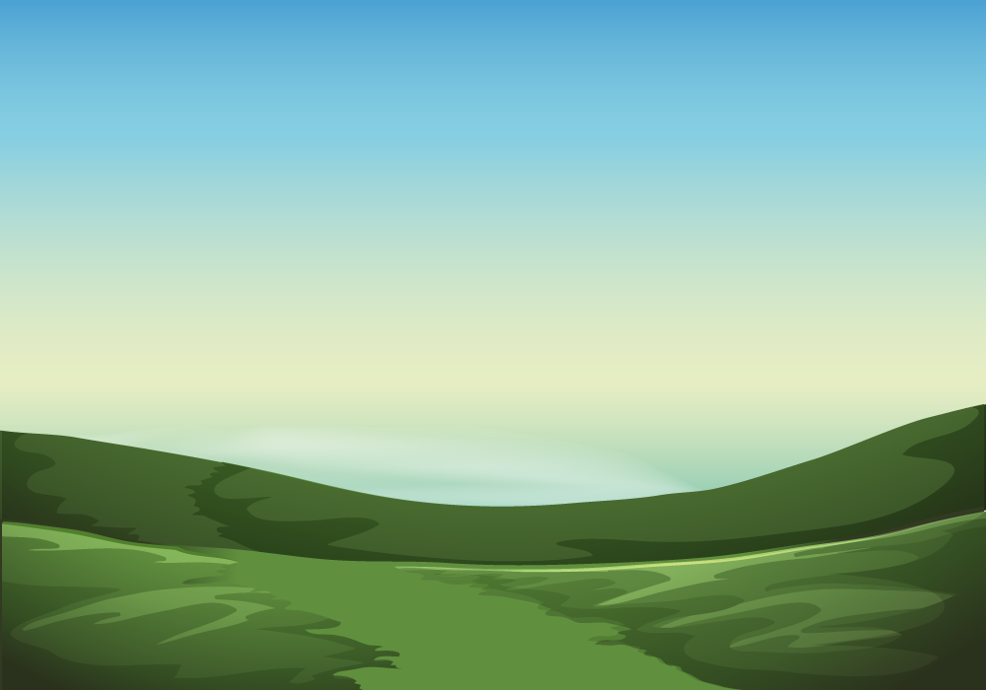


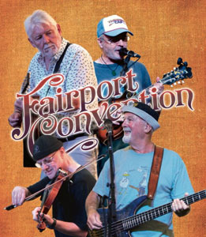
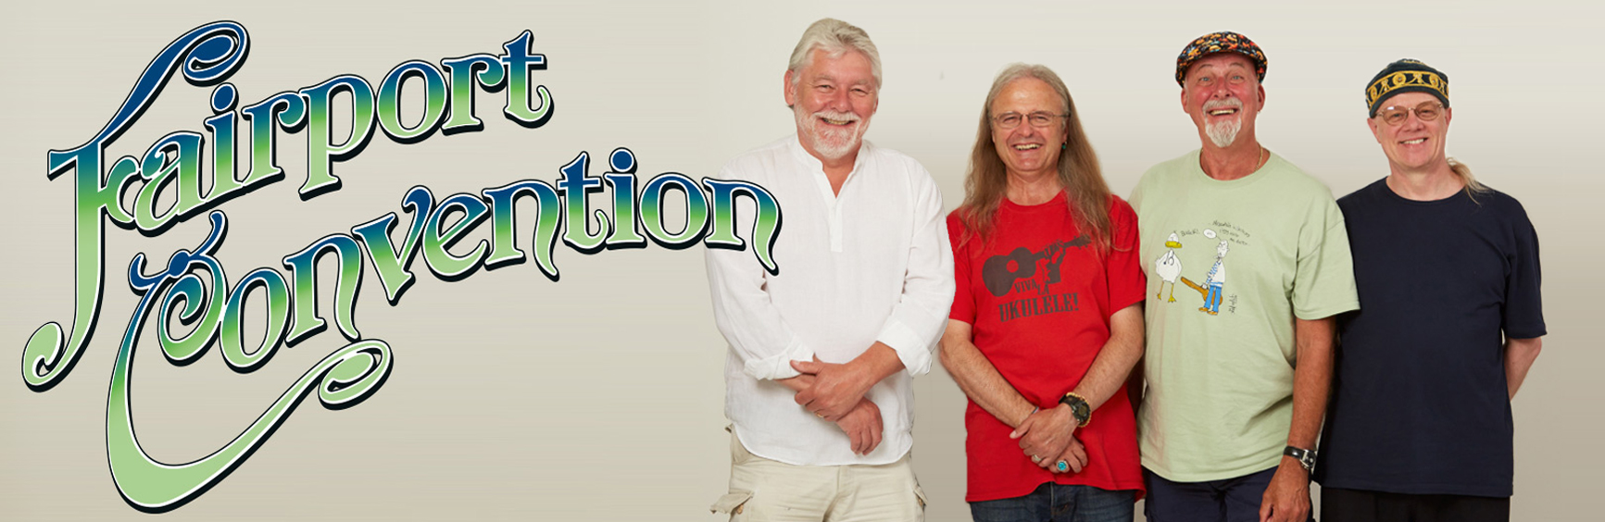
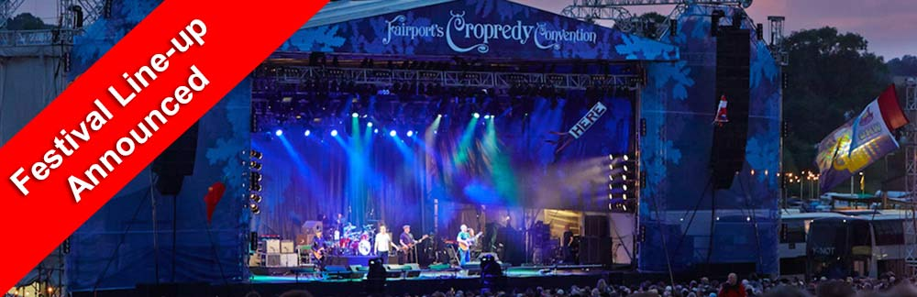
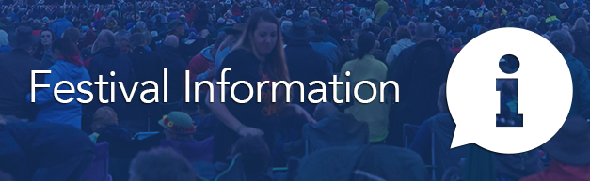
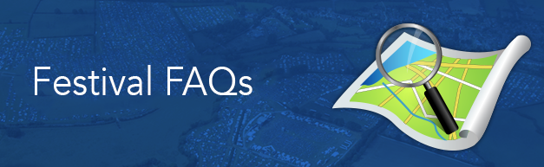
Asset table
Asset | Source | Intended Purpose / Description and suitability
 | link | This image can be used for background to add a more cheerful look to the website which is suitable for the purpose of the website as it displays what the locations the band might be performing at would be like and can be connected to other things that the audience of the band have seen.
 | link | this image can be used to display the band name on the headers on each page. This is suitable for the target audience as it shows the bands logo attracting people who are into the band and will be interested in their festival's
 | link | This image it's suitable for displaying the band name on headers or a favicon because it displays the band name and logo in a highly presentable way. This is suitable for the target audience as it shows the bands logo correlating this website to the band and attracting people who would be interested in their festivals.
 | link | This image could also be used for a favicon or two display the band members and name on pages. This is suitable for the purpose of the website as it displays the band to the user of the website and attracting the fans of the band.
 | link | this image is suitable for the history or about us page because it's displays band members and name very clearly. This is suitable for the target audience as it shows the bands and its logo which will attract the fans and target audience of the band as it relates the website to the band to people who are familiar with the band, the target audience.
 | link | This image shows what their festivals look like and can be used on their sights too display their gigs. This is suitable for the purpose as it advertises the festival and shows what it will be like.
 | link | This image can help to add more detail and make it look more professional when displaying information about festivals. This is suitable for the user requirements as it gives necessary info about the festivals for the users.
 | link | This image is suitable to make it clear to show that on this page will be displaying location of the festivals. This is suitable for the user requirements as it gives answers to the questions that the festival goers require.

Slide 4
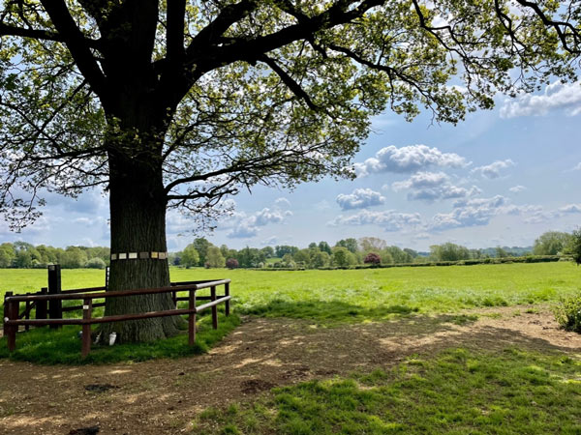
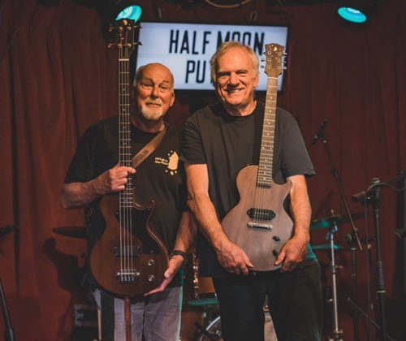
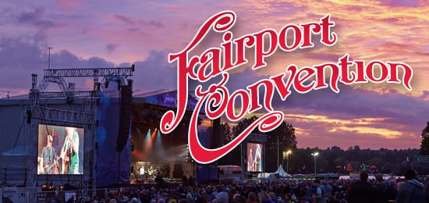
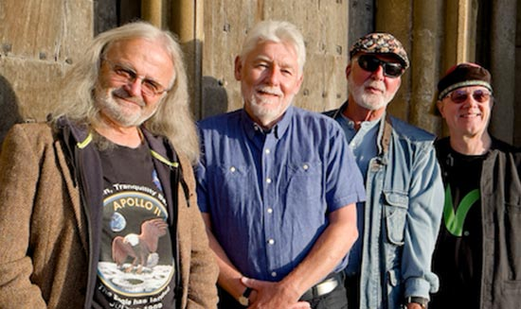




Asset table
Asset | Source | Intended Purpose / Description and suitability
 | link | This image is suitable for displaying locations and to help increase the positive atmosphere of the site. This is suitable for the target audience because it displays the location of the festival's and correlates what the festivals might be like to the audience and target audience.
 | link | this image can help display the members of the band and can be used on the about us or other pages.
 | link | This it's very suitable on the page which is displaying their gigs and turned events coming up because it displays that brand name and gives an idea of what it will be like.
 | link | This image is very suitable for the about us page because it displays the members of the band.
 | link | This image is suitable to display that they are a part of the association of festival organisation.
 | link | this image can be used to link to their Twitter page and is suitable for this because it is very clear what its purpose is considering the older audience.
 | link | this image can be used to link to their Instagram.
 | link | this image is useful to link to their Facebook page alarm or possible ways for users to contact the band.

Slide 5
test table
Number | Test | Expected Result | Actual result | Fix
1 | Pages load and link properly | the page should all link and load properly
2 | Images display correctly | all images should display correctly but some changes might need to be made
3 | it works on different devices and browsers | I'd expect it should work on most devices and it will work on all browsers
4 | hyperlinks working correctly | all hyperlinks should work correctly because this is quite simple
5 | navigation working correctly | I would expect all navigation to work correctly
6 | Suitable for its audience | It should be all suitable for its audience
7 | fulfils its purpose | it should fulfil its intended purpose

Slide 6
Proposed solution
My proposed solution for the website is to use eight individual pages, all linked to the home page, so it is easier to navigate, I have chosen this navigation because it is much simpler and offers clear navigation to all the relevant information. I'm going to add a dropdowns on some of the buttons to group together similar pages to one button that drop down in to two links to the individual pages, this makes navigation much easier to use with the target audience in mind.
I am thinking of using a table to show which bands performing when and where with links to Google map locations and two ticket sales this will make it much easier for the user to get the information they need fast and quickly.
Navigation chart
History
Home
Locations
Shop
Contact us
Newsletter
Festival's
Tickets sales

Slide 7
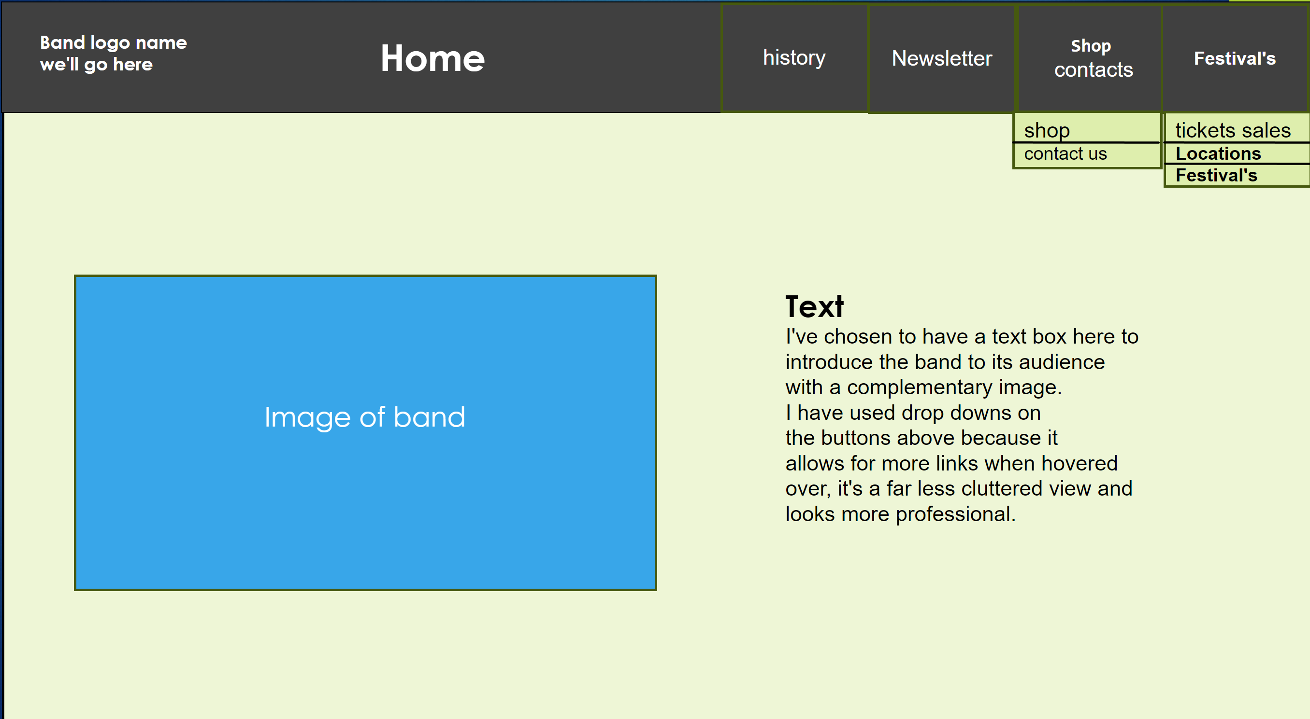
Storyboard
suitability to purpose and user requirements
This is suitable to the purpose and user requirements because it shows the logo of the ban to draw the target audience in and it has good navigation, I having handy drop downs with links to sites below for a less cluttered view to fulfil its user requirements.
It has images to display the band and some text to introduces the band to the audience to draw in its target audience and the image can help too great create a correlation between the band and website drawing in its fans which fulfils the purpose of the website.

Slide 8
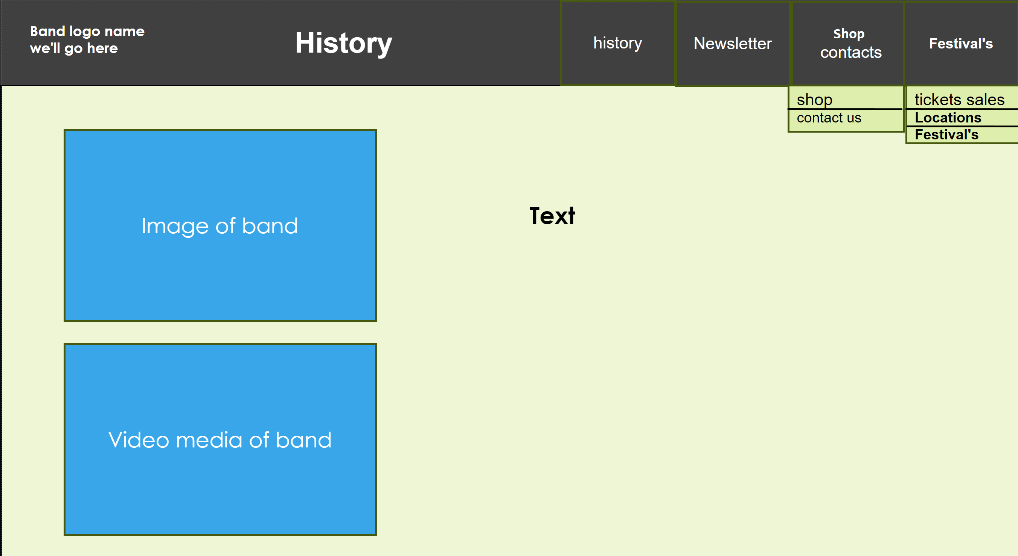
Storyboard
suitability to purpose and user requirements
This is suitable to the purpose and user requirements because it has multiple images of the band and its history with text to describe each image which fulfils the user requirements by giving them information about the band and the history educating them on what kind of a band, they are which fulfils the purpose of the website.

Slide 9
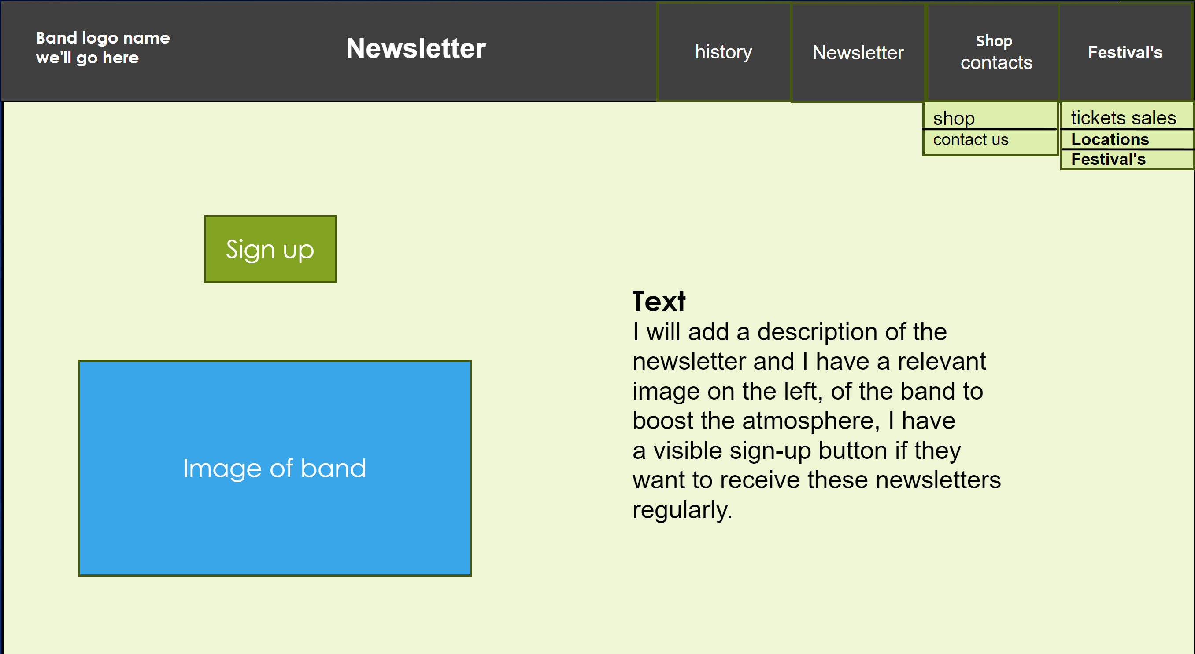
Storyboard
suitability to purpose and user requirements
This is suitable to the purpose and user requirements because it has a button to sign up with for filling the users' requirements of getting necessary information about when upcoming bands might be performing and when any festival's ah, which fulfils the purpose of the website.

Slide 10
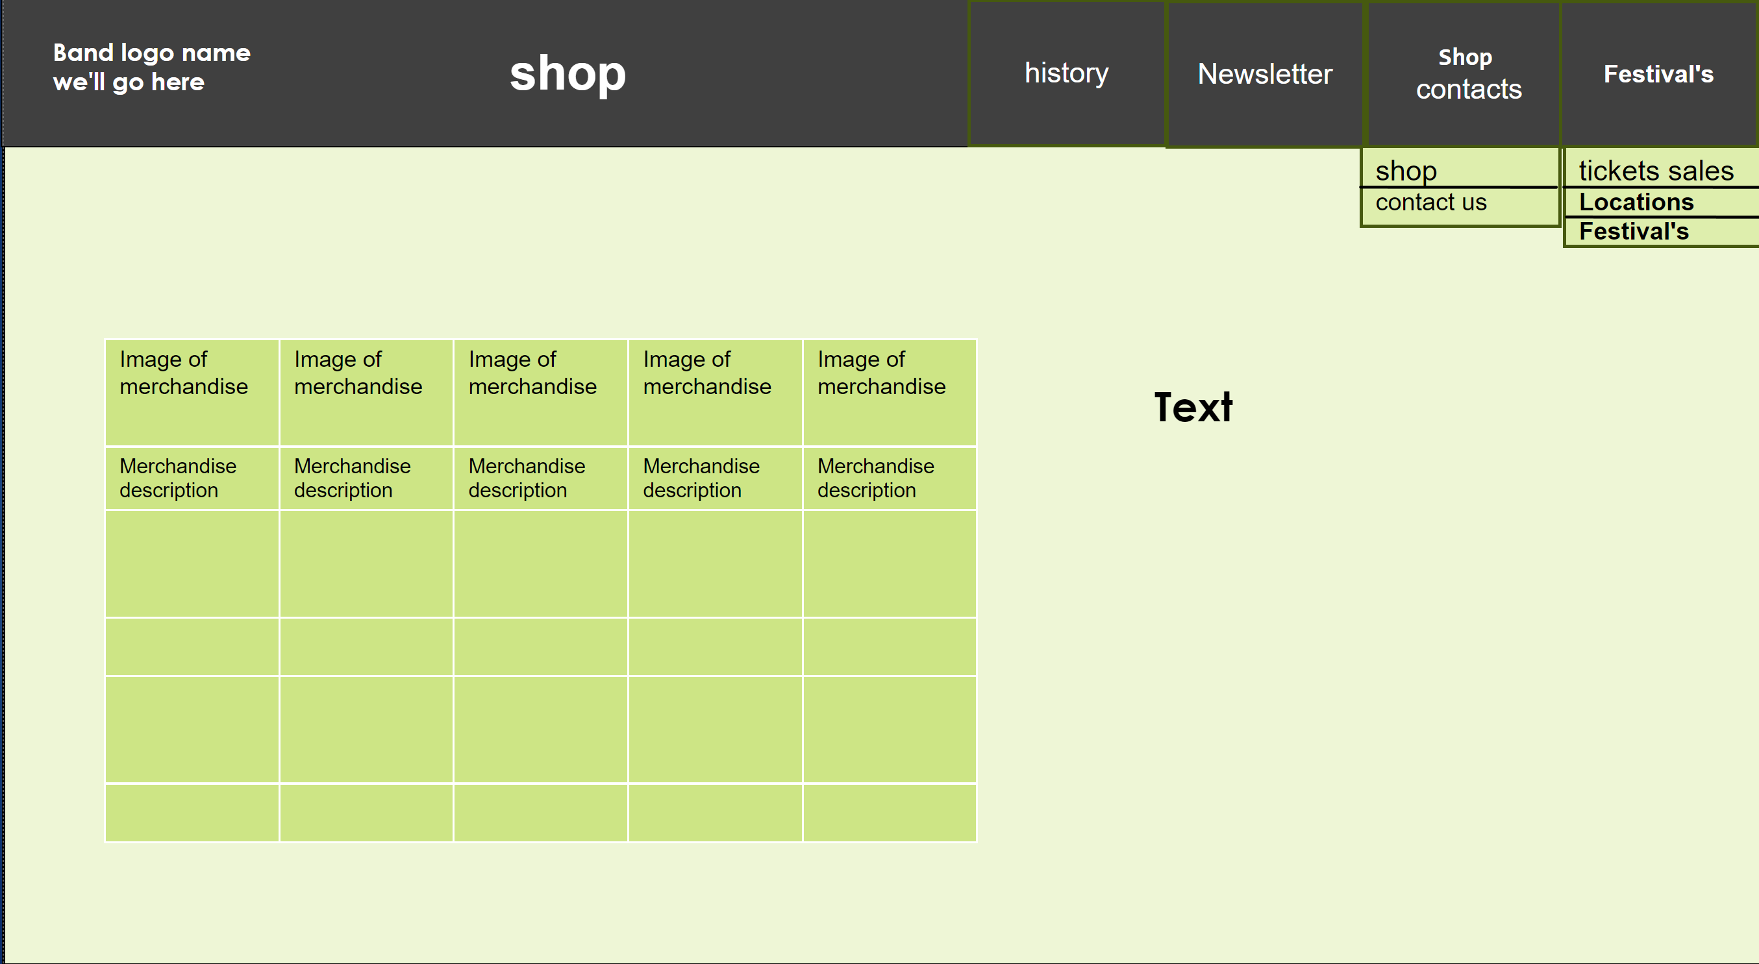
Storyboard
suitability to purpose and user requirements
This is suitable to the purpose and user requirements because it has a nicely laid out table to display or necessary information that the user requires and has a description of the product below the image too help educate the users of the website on what they could be buying fulfilling the purpose of the website.

Slide 11
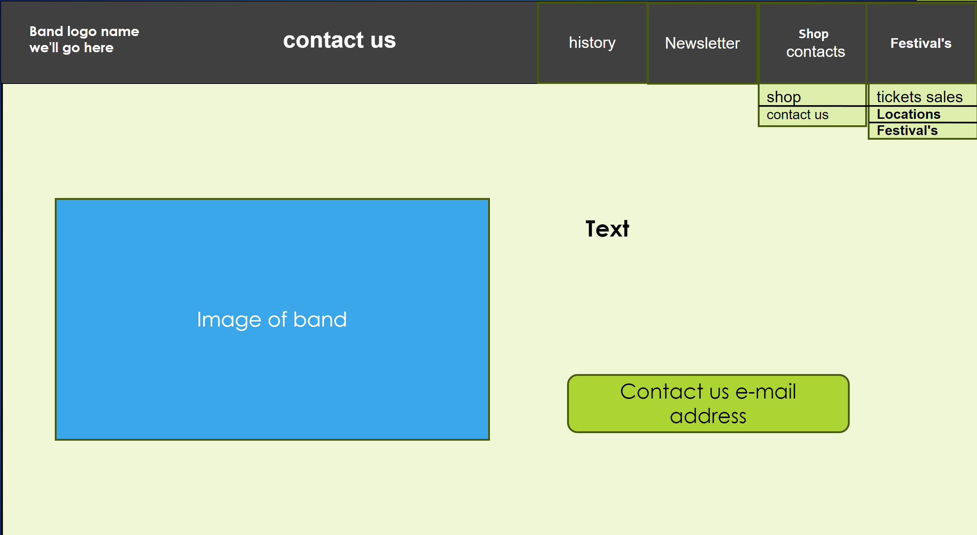
Storyboard
suitability to purpose and user requirements
This is suitable to the purpose and user requirements because it has contact details so users can contact the band and this fulfils the users' requirements, it also has images to create a better experience for the user fulfilling the purpose of the website.

Slide 12
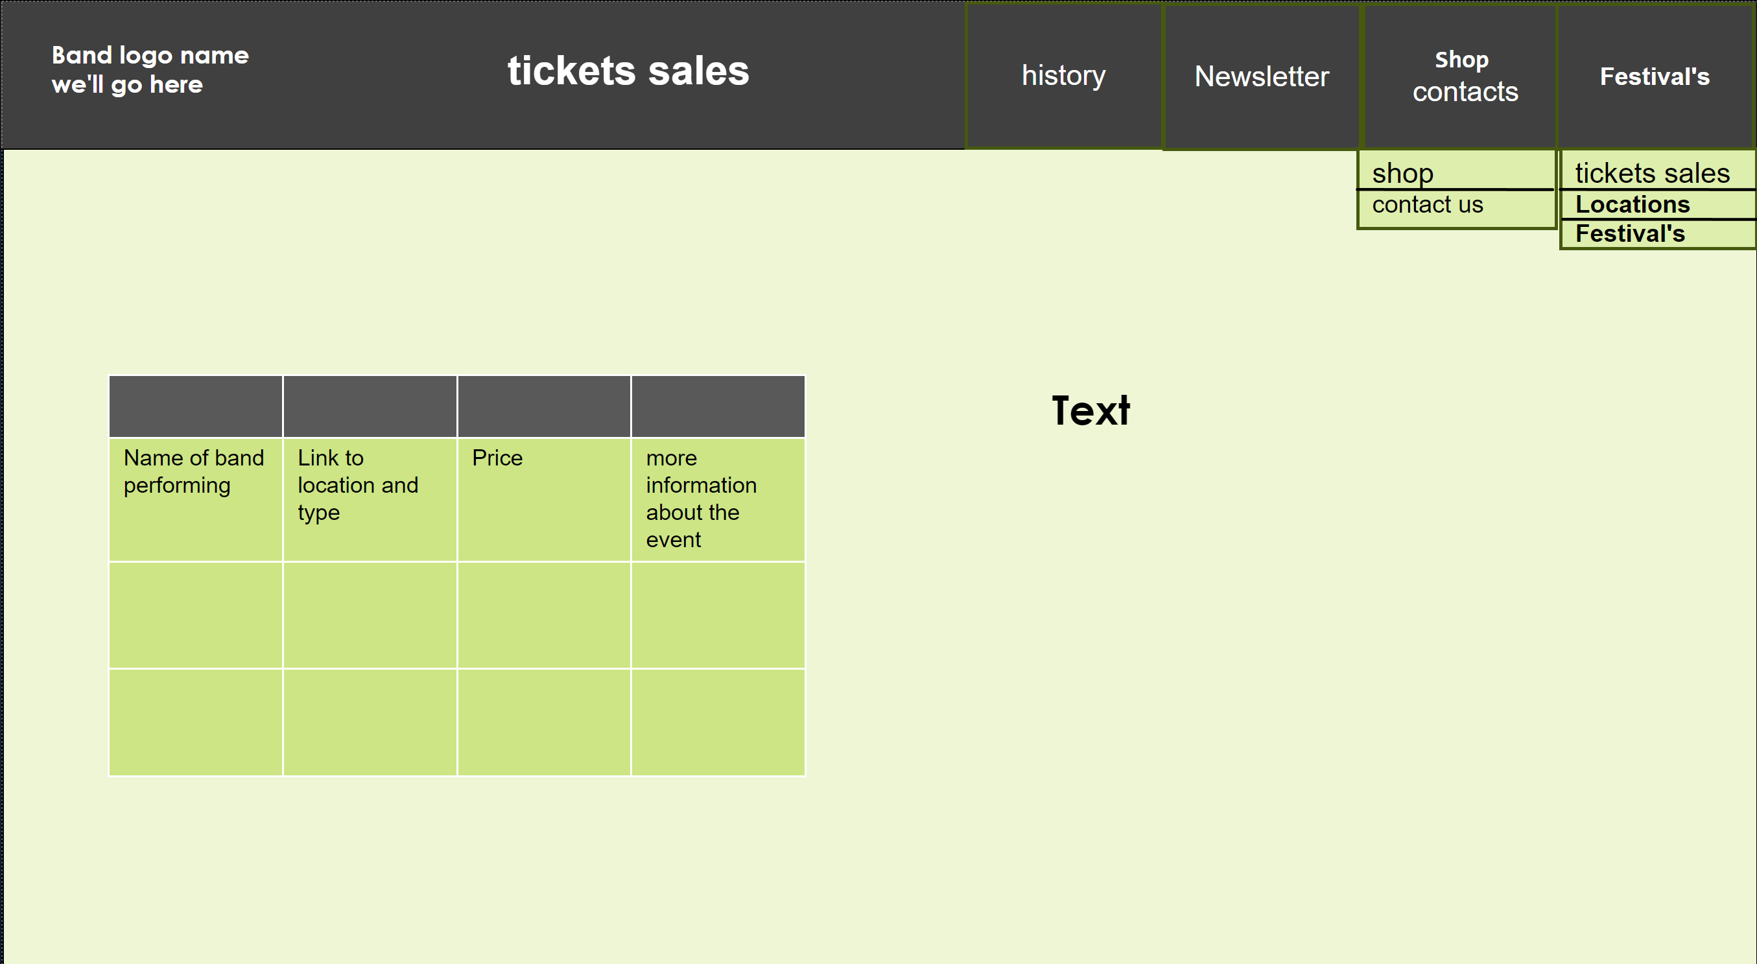
Storyboard
suitability to purpose and user requirements
This is suitable to the purpose and user requirements because it has a table to help display the tickets being sold and information going with it to fulfil the users' requirements for the site, it also has some text to display more information for the user, so this fulfils the purpose for the website, and with the good navigation and top bar with all necessary information, this creates a very user-friendly site fulfilled all the needs of its uses.

Slide 13
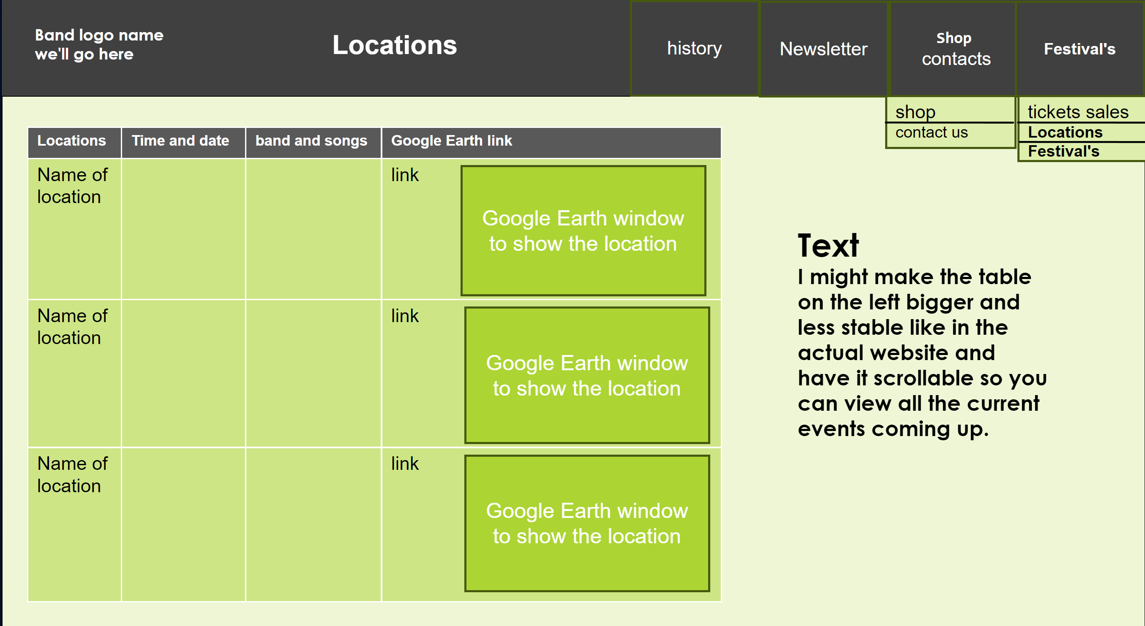
Storyboard
suitability to purpose and user requirements
This is suitable to the purpose and user requirements because it has Google map location window with a clear table to show the band performing and more information like date and time, this is suitable for the users' requirements because it displays all this information and fulfils a purpose of the website as well.

Slide 14
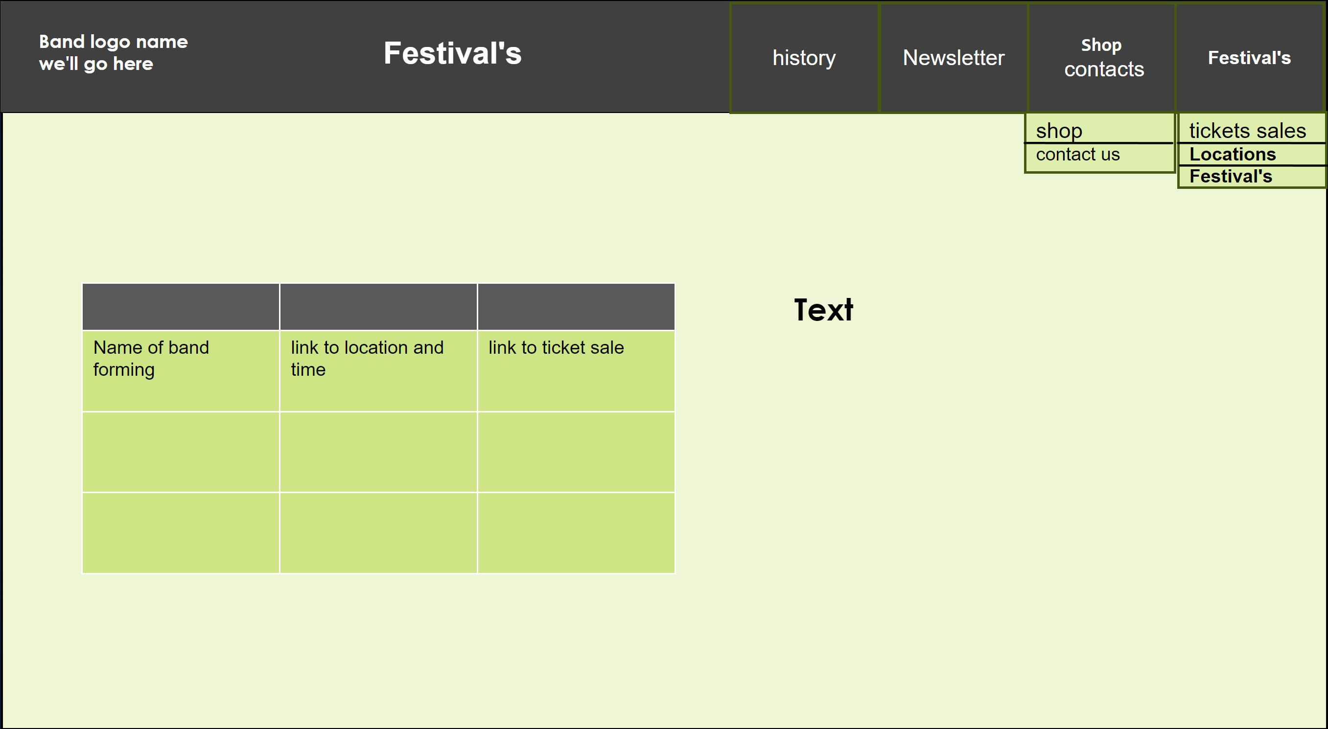
Storyboard
suitability to purpose and user requirements
This is suitable to the purpose and user requirements because it has a clear table to show which festivals are coming up and links to locations and ticket sales for the users. this fulfills the purpose of the website, and because I have giving all necessary information to the users this fulfilling the users requirements for the website.

Slide 15
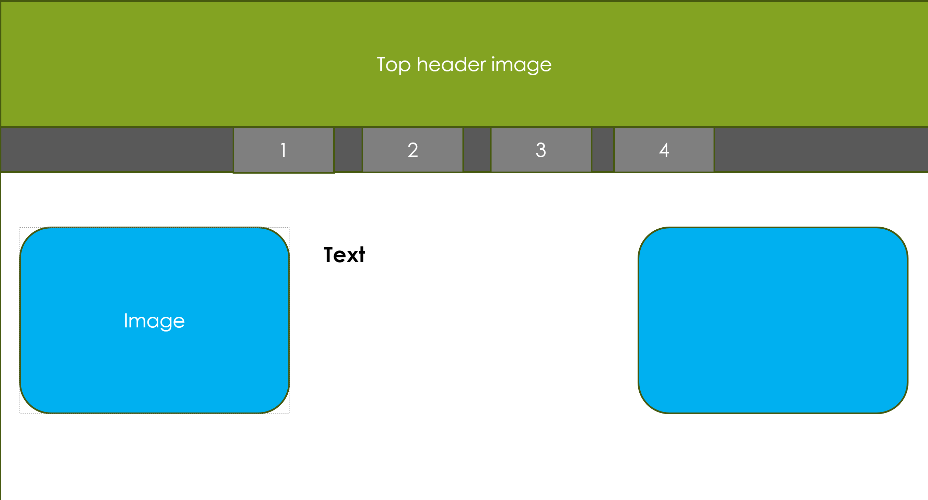
Alternate designs for the Storyboard
Why I discarded this design
This design has not got very clear navigation and has interestingly laid out imagery but this doesn't fulfill the requirements of the website with only having four links to pages on the home page making navigation far more impractical therefore not fulfilling the requirements of the website.

Slide 16
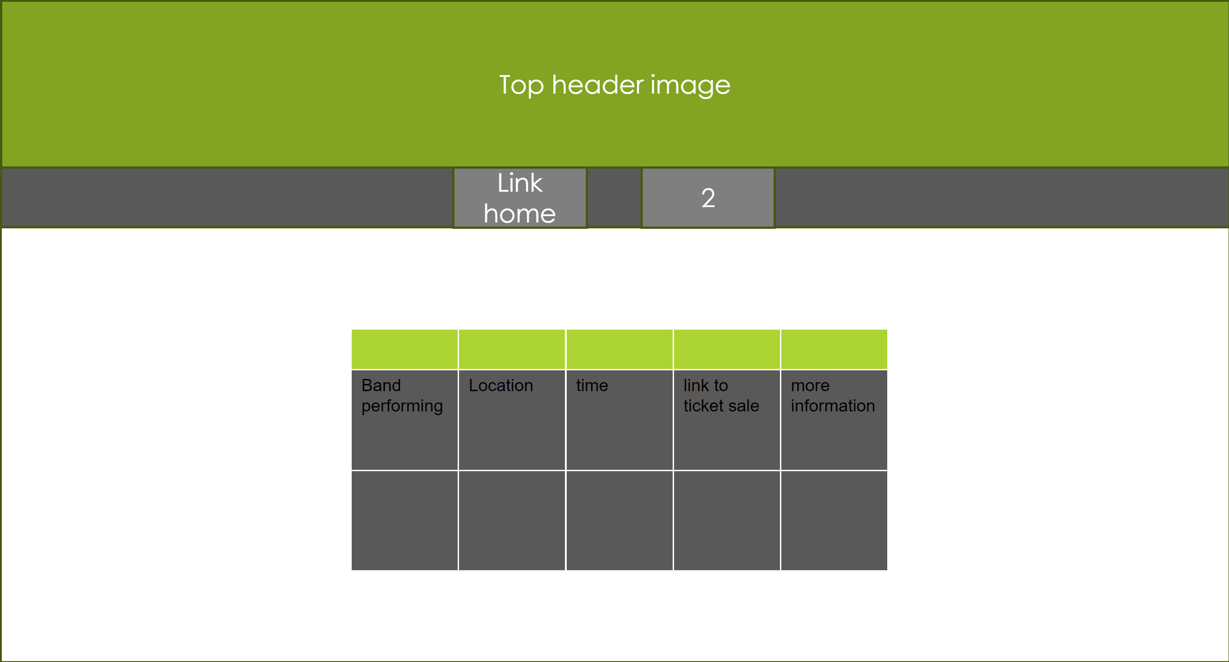
Alternate designs for the Storyboard
Why I discarded this design
This design does have a table for filling some of the requirements but has lack of text boxes for descriptions and more information making it harder for the user so it does not fulfill the purpose and requirements for the user.

Slide 17
Alternate navigation chart
I discarded this navigation chart because it is much harder to navigate and use due to having page is only accessible through another page which makes the navigation far less intuitive. this can become quite confusing for the user if they've never used the site before. This isn't suitable considering the target audience and requirements for good navigation.
Navigation chart
Home
Shop
Festival's
Locations
Tickets sales
Newsletter
Contact us
History

Slide 18
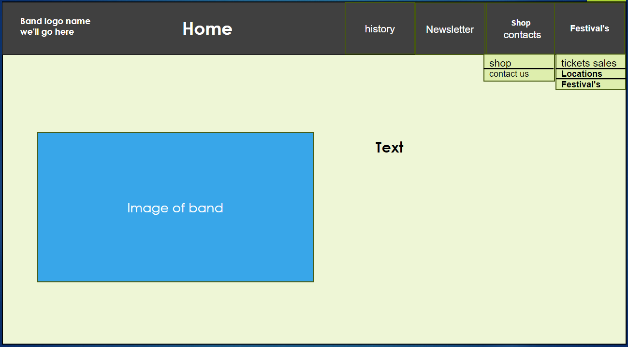
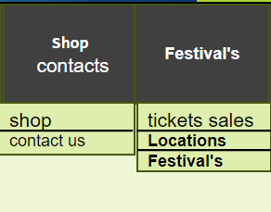
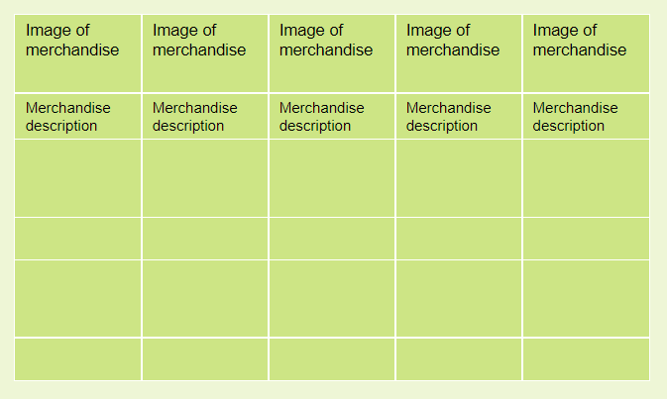
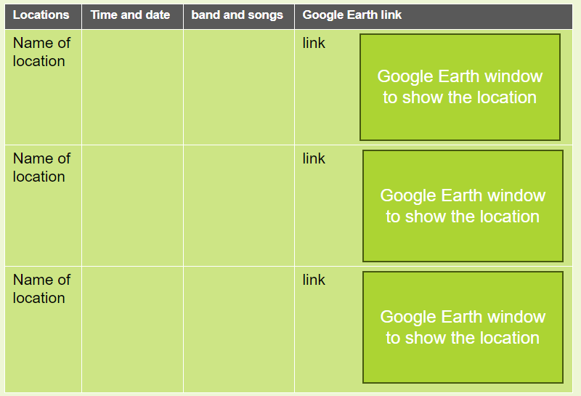
Justification for design choices
I chose the first design because it is more professional and is much easier to navigate.
Some of the constraints I have with my design is the drop downs from the buttons, which are going to be quite complicated too code and function correctly although I think it is worth it because is far more logical and intuitive navigation.
These design choices for Philly the user requirements by having all eight interlinked pages she to navigate through.
I there is to have fairly simple and logical layout with just one image and a text box below a bar with logo and links to pages, this design is relatively simple but can be used to display all relevant information. I have tables to display the bands performing and also to display items for sale for filling the requirements for the website.
I have chosen to use the Google map window inside a table to display which band is performing their location and links to ticket sales and other relevant information this allows for multiple events to be displayed at the same time and clearly shows which location is linked to which event making it easier for the user to access the relevant information.

Slide 19
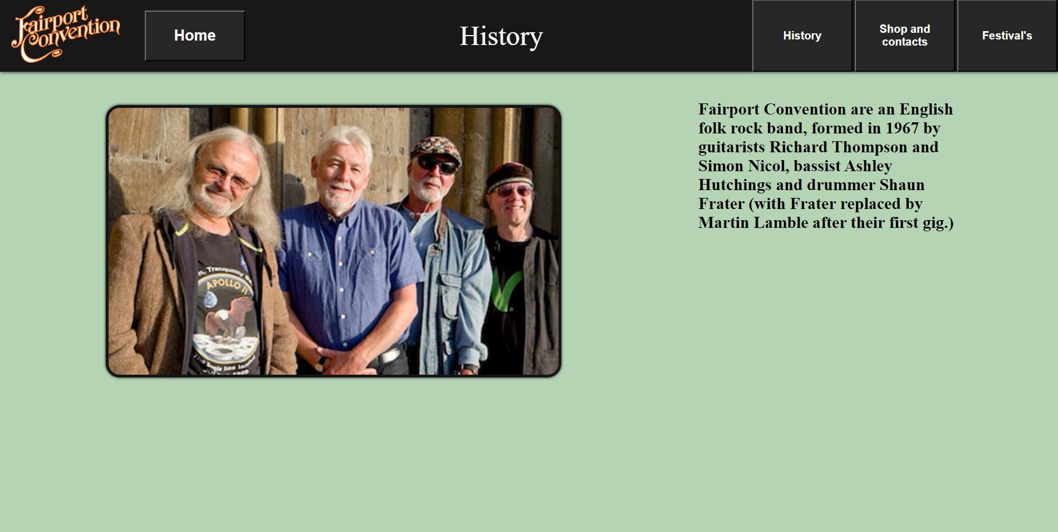
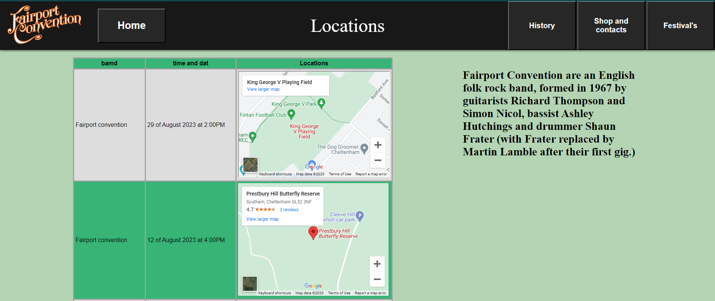

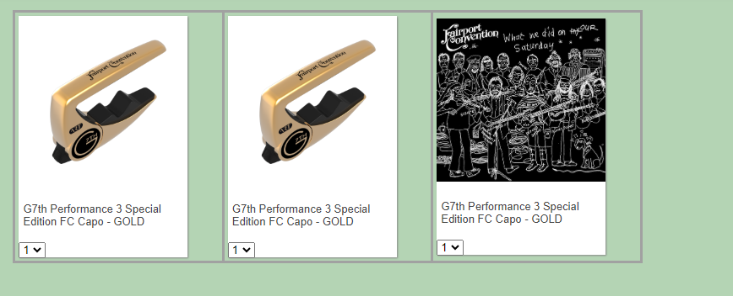
How the website is suitable for the intended audience and purpose
My website is suitable for the intended audience and purpose because it has clear navigation to sites that have lots of relevant information like locations times and more information about the bands performing fulfilling the requirements of the user and purpose of the website.
The website also has clear navigation and handy drop downs to display information making it easier for the user to access what they need fulfilling the purpose of the website and making it easier for the users to navigate fulfilling the users requirements.
The site also has tables to display information and Google Earth windows to show locations this is suitable for the audiences requirements and fulfills the purpose of the side by displaying all the relevant information on the sites and making it easier to find it fulfilling the purpose and user requirements of the site.
My site is also suitable for the audience and purpose because it has a handy button at the top to navigate directly home making it easier for the target audience and navigate fulfilling the user requirements of the site.
My site also has clear links to locations and time as well as more information about the band with tables about the festivals coming up and links to ticket sales this fulfills the requirements of the user and fulfills the purpose of the site.
My site also has a shop where things like merch and music can be sold to the audience fulfilling the purpose of the site and it also displays the price and about it, which fulfills the requirements of the user.

Slide 20
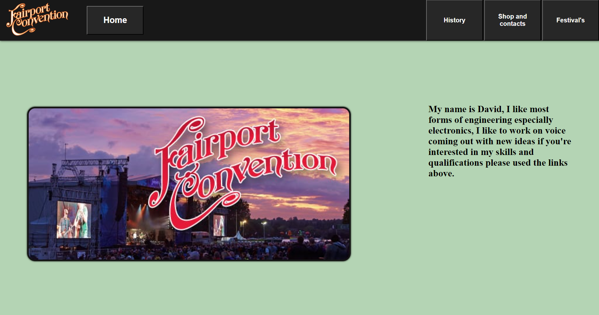
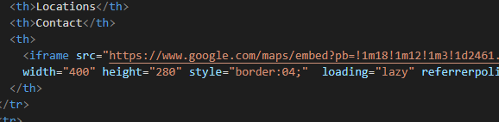
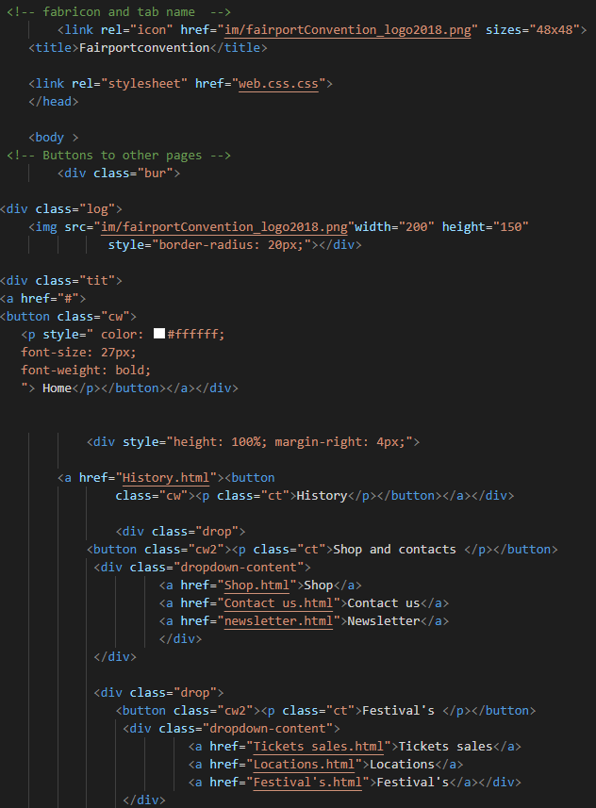
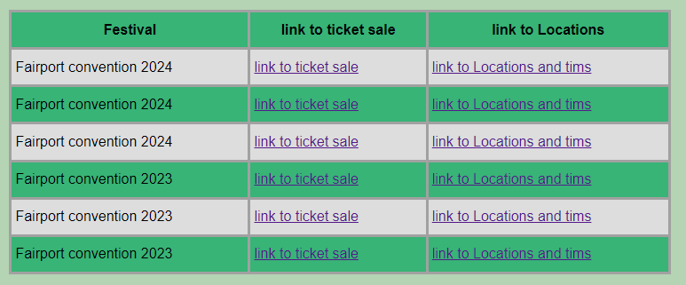
How I developed this site and combined assets
I followed my designs for the top header with navigation although I added a button on the left to navigate directly home and move the newsletter into the drop and contact us drop down.
I added the link to the Google Maps window into my page using the inbuilt feature in Google Maps to copy the code into your website.
I was able to use the table element to create a table to display bands performing and items in the shop.

Slide 21
test table
Number | Test | Expected Result | Actual result | Fix
1 | Pages load and link properly | the page should all link and load properly | all my pages load and link properly although ones with more content like the linked Google map window takes longer.
2 | Images display correctly | all images should display correctly but some changes might need to be made | All images are displaying correctly as intended. The favicon on doesn't display itself on the top of the tab. | I changed the fabric, an image to an icon and updated the code and it displays correctly now.
3 | it works on different devices and browsers | I'd expect it should work on most devices and it will work on all browsers | I found it worked fine across multiple browsers, it doesn't display the right resolution on different devices. | adjusting the height or width of an object to percent rather than px so it displays the right resolution.
4 | hyperlinks working correctly | all hyperlinks should work correctly because this is quite simple | all hyperlinks between websites work correctly.
5 | navigation working correctly | I would expect all navigation to work correctly | all my navigation is easy to use and understand and working correctly.
6 | Suitable for its audience | It should be all suitable for its audience | my website is suitable for the audience but could be more detailed in what information is displayed. | adding more content and text to give the information required from the audience.
7 | fulfils its purpose | it should fulfil its intended purpose | it fulfils its intended purpose.

Slide 22
Feedback Form
Website link
 | Look of site | Functionality | Feedback | Suggested Improvements
1 | This site looks me and has a nice atmosphere and things are not only size, so it is easy to see what is on the side. | I found the site functioned correctly with 0 hiccups or problems; the Google map windows well very helpful. | I think This site is wonderful and there are not many improvements that could be made often a few navigational and functional changes for optimization. | I would change how do you view which bands are playing with just one page to see everything and then one separate page to buy tickets for easy access to necessary information
2 | The site looks good although the content and colour schemes could be more relevant. | I found the functionality of the website work perfectly from what I can see. | The site looks good although some of the content could be made more relevant to the band. | I would modify the layout and colour scheme to be a bit more relatable to the band and their theme. An example would be to change the background colour to an image with more relatable content to the band.
3

Slide 23
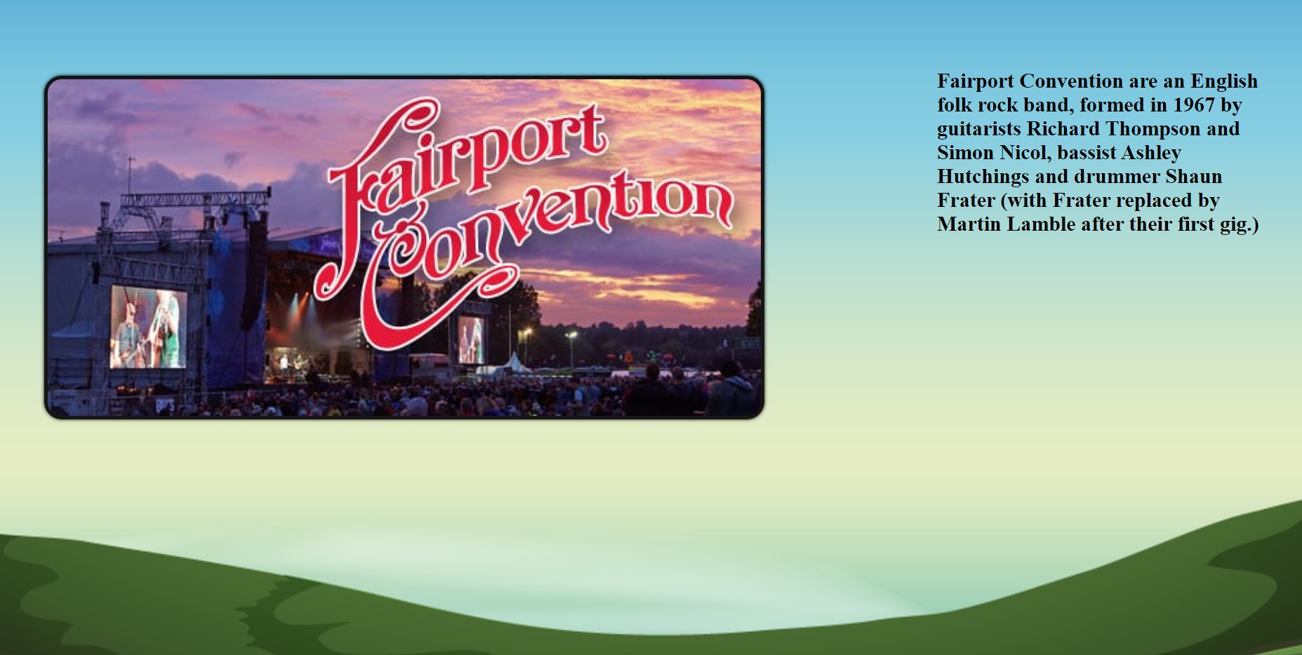
Home
Tickets sales
Changes and fixes based off feedback
Based off some of my user feedback I have created a new navigation chart with changes that I will implement to the site for easier navigation and functionality with allows for quicker access to necessary information.
I'm also changing the background colour to an image for a more relevant look to the band and audience.
History
Festival's and
Locations
About the band
Shop
Newsletter
Contact us

Slide 24
self review of my website
I made sure the website was suitable for its intended audience and purpose by adding clear navigation with a button up the top to easily get home and Google map links for locations of festivals, so it is easier for the user to get the location and time of the festival quickly creating a better user experience. I added tables in the festival page so they can see all the festivals for bands performing and when and links to any other details.
I have also added pity air media after the audience can review what the fans content is like and get a preview.
Evaluation against inshore designs
I change the background display to a more relevant design to the band, this is better than the original background which was just a bland plain colour which word not of look very inviting to the audience

